Slide 1
DELex
A lexer designed for C Programming language

Slide 2
Why lexer is needed?
Lexer is needed for tracking the strings inside the compiler, but problem arises is that these strings cannot be fetched directly for our purpose inside a parser, it can be done but programming will become very complex and maintenance of the code will be very hectic Lexer converts your string into an integer based token reducing your memory consumption.These tokens can be used till code generation layer.

Slide 3
Architecture
We have our own string, tape(file reading) library for working with C++ style library for C. these libraries are more aesthetic, more verbose, crash-free and easy to fix. These libraries always use dynamic memory and continuously reallocates memory for being crash-free. We have rigidly designed the syntax to be compatible for C89 standard. We are fetching each token by it’s position in the file tape_t.h will provide the file content as single string, this is an example of hello world program #include <stdio.h>\n#include<stdlib.h>\nvoid main()\n{\nprintf(“hello world!”);\n}\nEOF

Slide 4
Architecture
As given below you can see we are getting the string by position, and we reading the token until we encounter an EOF
The variable i itself tells the position inside the file and gets updated by getTokenByPos() function
for (i = 0; t != EOF;)
{
printf("Returned token is:%d\n", t = getTokenByPos(str, &i, meta));
debug_lex(t);
}

Slide 5
Starting of the program
We have choose to fetch the Token by position as, we can again fetch the same token using the same position in the file so it is resuable as much as possible, if any issue occurs then it may also tell us where the problem is occurring the file using position value int getTokenByPos(string_t str, int *k, string_t metadata)
{
static int line_no = 0;
int pos = *k;
static bool is_enclosed = false;
static bool is_comment = false;
static bool is_block = false;
int start_pos = 0, last_pos = 0;
int start_str_pos = 0;
START: // starting point of the code

Slide 6
Preprocessor ignoring
Is_prep() checks whether your first character is ‘#’ or not , if it’s ‘#’ then it ignores the entire line #ifdef NO_PREPROCESSOR
skip_spaces(str, &pos);
is_prep(pos);
#endif

Slide 7
New line/whitespaces at beginning of a file
if (at(str, pos) == '\n')
{
// printf("%d %d %d\n", pos, line_no,str_line[line_no].at(pos));
printf("New Line\n");
// cout << str_line[line_no] << " " << CHAR_AT(pos, line_no) << endl;
line_no++;
pos++;
} while (at(str, pos) == ' ' || at(str, pos) == '\t' || at(str, pos) == '\v') // Ignore all whitespaces
pos++;

Slide 8
Comment handling
if (is_comment == true)
{
while (at(str, pos) != '*' && at(str, pos+1) != '/')
pos++;
if (at(str, pos) == '*' && at(str, pos + 1) == '/')
{
pos += 2;
is_comment = false;
goto START;
}
}

Slide 9
List of Tokens
People always confuse tokens with expressions, statements or blocks 1) a single character token can also exists like { ,}, ; , “ , > etc. 2) keywords or identifier is also a token 3) Integer constant or floating point constant or string pool or character constant is also a token
What are the things that are not token ? 1) a * b = c; (in this expression a*b is not a token but it is combination of tokens) 2) /* hello */, comments are also not tokens 3) @ is not a token as it is invalid character 4) for(i=0; i; i++) , this is a for loop statement it is not a single token, it is combination of tokens like ID ‘(‘ ID ’=‘ ‘0’ ‘;’ ID ‘;’ ID’++’ ‘)’

Slide 10
State Machine part
We have divided our entire state machine into 3 sections:-
1) Single or 2 character section
2) Keyword section
3) Identifier section

Slide 11
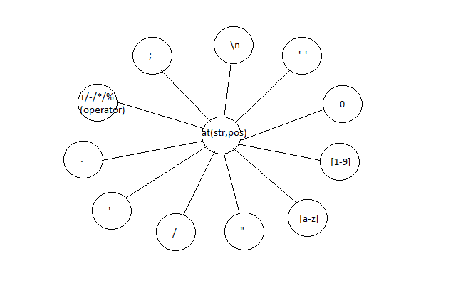
State Machine part – 1) Single or 2 character – single char handling

Slide 12
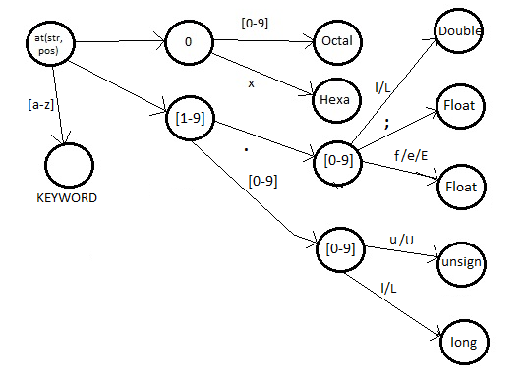
State Machine part 1) Single or 2 character- constant literals

Slide 13
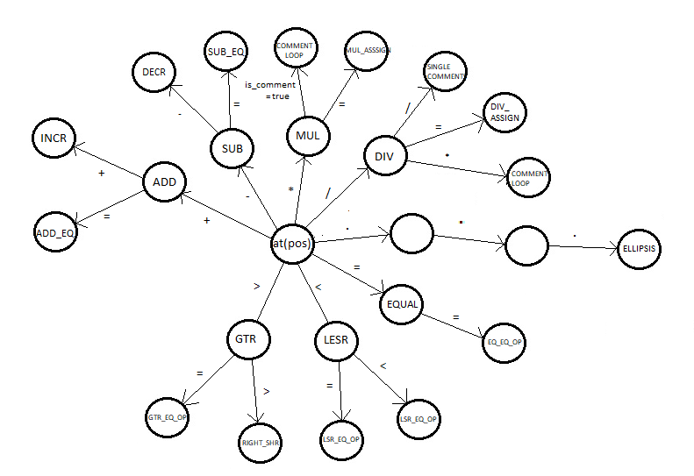
State Machine part 1) Single or 2 character- operators

Slide 14
COMMENTLOOP label
Commentloop label is used for ignoring the comment strings in any file we are updating string postion whenever we read a comment string we also need to check in the commentloop the place where comments is ending

Slide 15
COMMENT LOOP
else if (at(str, pos) == '*')
{
pos++;
is_comment = true;
//printf("File changes %s", str->str);
//skip_spaces(str, &pos);
COMMENTLOOP:
do
{
//printf("is comment!");
if (at(str, pos) == '\n')
{
line_no++;
}
else if (at(str, pos) == '*')
break;
pos++;
} while (at(str, pos) != '*'); … continued
… continued if (at(str, pos) == '*')
{
pos++;
//printf("comment new line %d\n", at(str, pos));
if (at(str, pos) == '\n')
{
line_no++;
pos++;
goto COMMENTLOOP;
}
else if (at(str, pos) == '/')
{
//printf("comments ended! %c\n", at(str, pos));
is_comment = false;
pos++; // Comments have been completed, just ignore the comments(do nothing) and go to beginning of the code
//printf("comments ended! %d\n", at(str, pos));
goto START;
}
else
{
pos++;
goto COMMENTLOOP;
}
}
else if (at(str, pos) != '/')
{
goto COMMENTLOOP;
}
}

Slide 16
State Machine- 2) Keyword section
Keyword section is for the character handling from ‘a’ to ‘z’ There is a label name “KEYWORD”, whenever we get ‘a’ to ‘z’ in someother part of the code then we will jump to label “KEYWORD”
We will run a loop to count the number of characters in the string if our string length is 1, we will assume it to be an Identifier and return immediately if our string length is greater than 1 we will check if it matches with some predefined keywords of C language such as “if”, “do” etc. as well as check the end of the string for error checking, suppose we have “int)” this can be valid as function declaration can end with ‘)’ or “hello (”, this can be function definition or declaration “hello@” is an error scenario
If our string is not a keyword we will jump to IDENTIFIER section
Invalid/error scenario occurs for @, # , $ and string which is not enclosed

Slide 17
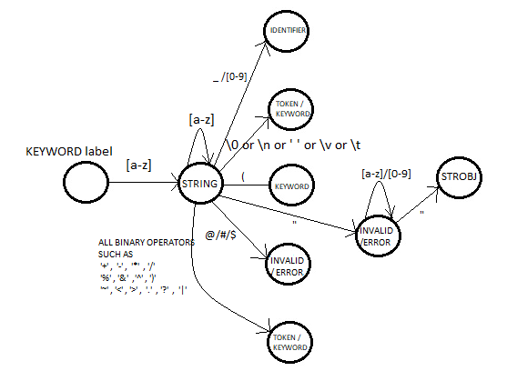
State Machine- 2) Keyword section

Slide 18
State Machine – 3) Identifier section
IDENTIFIER label is used to identify whether the string is an identifier or not we have limitation of 512 characters for an identifier we have taken 2 variables as start_pos and last_pos to read the identifier we are running a while loop for alphanumeric characters and checking the first character is digit or not, which is illegal, the loops help in setting the last position variable(last_pos) after the while loop we have to check for the size of identifier, it should be smaller than 512 the final check is for the last character after the identifier, we need to check whether the last character is a valid terminating character like spaces, semicolon, operators etc.

Slide 19
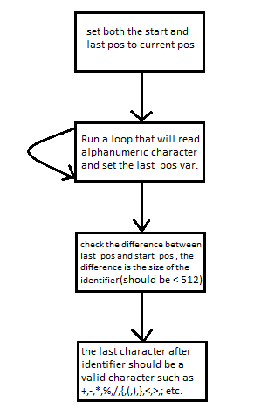
State Machine – 3) Identifier section state diagram

